Slide 1
An inquiry learning progression for carbon-transforming processes
Dr. Jenny Dauer
Michigan State University
Department Teacher Education

Slide 2
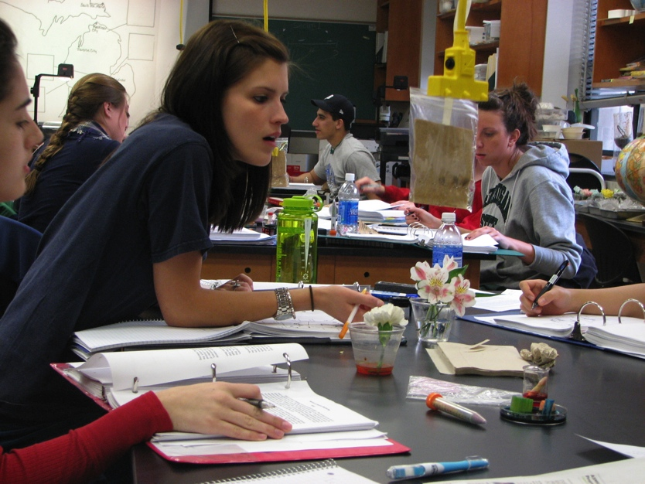
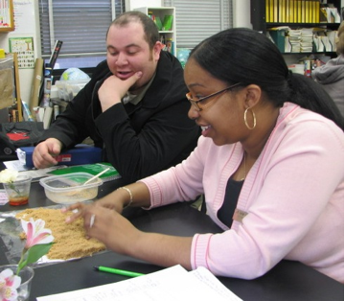
Inquiry practice—important learning goal
Students need to develop an understanding of the practices of science, which is as important to understanding science as knowledge of its content (NRC K-12 Framework)
Photo credit: Dr. Jane Rice
Notes:
Inquiry practices are important learning goals for environmentally literate citizens
Inquiry is a scientific practice because we want students to be able to DO something, and we talk about it in that way, as “a practice” not as a pedagogical method (It includes students doing measurements, looking for patterns in data and making arguments from evidence.

Slide 3
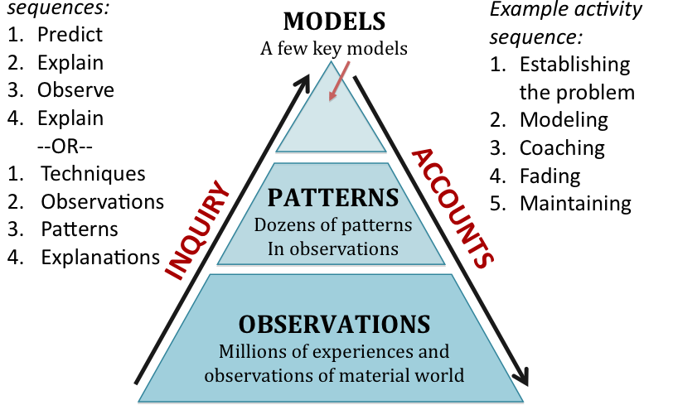
What is inquiry?
Notes:
Inquiry is what scientists do, it’s a complex set of practices… these are the particular practices that we focus on:
O-> P ->M
In comparison, an account is applying a theoretical model to explain or predict a phenomenon.
This is what we mean when we are talking about inquiry.

Slide 4
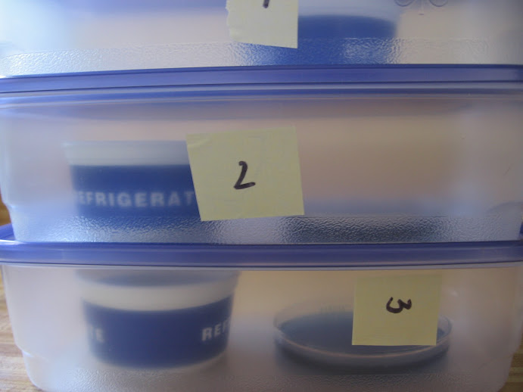
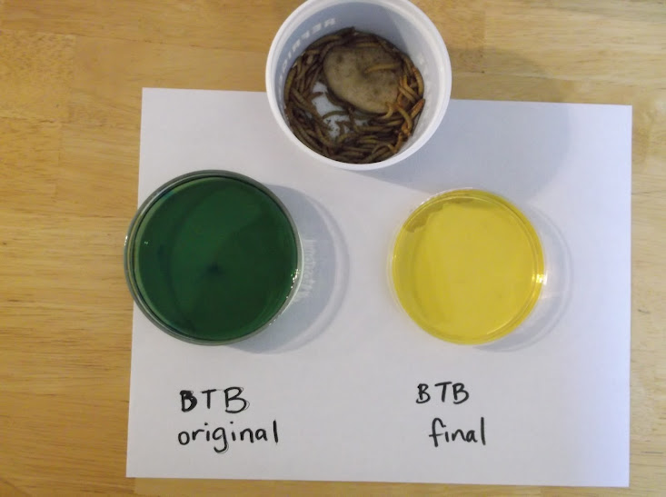
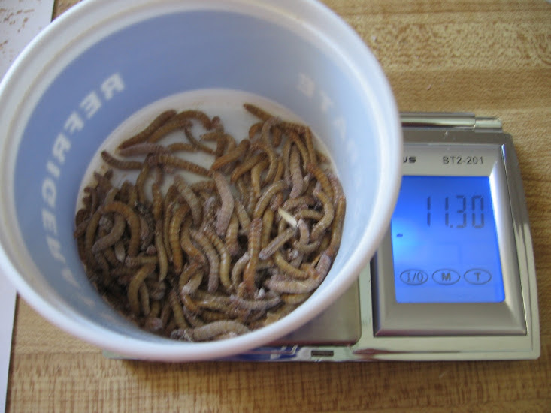
Inquiry practices in a context
Describe how students reason when doing inquiry investigations about carbon transforming processes
Other inquiry learning progressions:
Argumentation (Berland & McNeill, 2012)
Modeling (Schwartz, 2009)
Notes:
Inquiry practices involve simultaneous coordination of both knowledge and skills,
so we are studying inquiry in a context of investigations about carbon transforming processes. Which parallels our learning progression framework for accounts (or student explanations).
Specifically, we are interested in how students interpret investigations where macroscopic measurements and observations provide evidence about atomic-molecular processes. Know from our research that students have a hard time understanding these investigations, and connecting macroscopic phenomenon to chemical processes.
For example: CR and mealworms…… interested developing a learning progression of changes from middle school to college level. Other LPs not specific to a context.

Slide 5

Uncertainty a core issue for scientific inquiry
The practices of scientists:
identify sources of uncertainty
estimate the extent of uncertainty
Engaging in practices that reduce uncertainty
Notes:
Scientific inquiry is a way of knowing about an uncertain world.

Slide 6
Uncertainty a core issue for scientific inquiry
The practices of scientists:
Measurement– Commitment to critique and rigor in research methods
Pattern finding– Use statistical techniques to understand variation in data
    Argumentation– Giving authority to arguments from evidence rather than individual people
    Metz, 2004; Kahneman, 2011; McNeill & Krajcik, 2008; McNeill, 2011
Notes:
For example:
Measurement– consider sources of experimenter and systematic error & limitations of instruments
Pattern finding–accuracy and precision
Argumentation– claims, evidence, reasoning
Today I’ll primarily talk about Argumentation

Slide 7

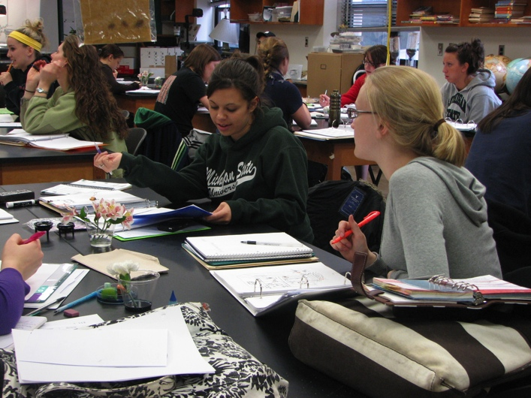
Research Populations
Middle School and High School students (n=150)
Undergraduates pre-service elementary school teachers at MSU (n=40)
Notes:
Data from 2 research populations.
In a science content class about matter and energy that covers astronomy, geology, climate, biology
Students have a non-science focus like history or language arts
Written and interview data inform this work– I’ll talk about interview data

Slide 8


Karen and Mike Interview Question
Plants gain most of their weight from materials that came from nutrients in the soil.
Plants gain most of their weight from materials that came from the air.
Karen
Mike
Notes:
“We are interested in how people use evidence to support their ideas. We’re going to talk about two students who disagree with each other about how plants gain weight when they grow. One student Karen said: “The plant gains most of its weight from materials that came from the air.’
“Another student, Mike said: ‘The plant gains most of its weight from materials that came from nutrients in the soil.’
Student identifies the student they think is right and that’s where we start.

Slide 9
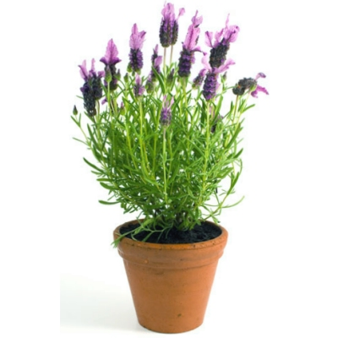
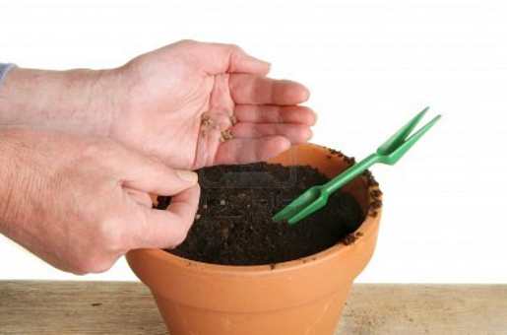
“How does Karen’s argument support her idea that plant gains weight from materials that came from the air?”
You can grow a big plant in a little pot without a lot of soil.
Seed = 1 g
Plant = 50 g
Soil = 80 g
Karen
Soil = 78 g
Seed planting
One year later
Notes:
Karen explains, ‘You can grow a big plant in a little pot without a lot of soil.’ Karen adds some evidence to her argument and explains ‘A seed weighing 1 g was planted in 80 g of soil. After two years the plant weighted 50 g and the soil weighed 78 g.’
“How does Karen’s argument support his idea that plants gain weight from materials that came from the air?”
“Are their some weaknesses in Karen’s argument? Explain what they are.”
What evidence would strengthen Karen’s argument?
So, the soil did not lose as much weight at the plant gained. Mass must come from a source other than soil.

Slide 10
Purpose of Investigation | Strategies for argumentation
Naïve inquiry Find the cause: What made an event happen? | Claim is cause and effect regardless of stated research question. Evidence, including personal experience, shows connection between cause and effect
Naïve engineering Find the winner or the best approach: What way works best? | Claim is about what works or how to make something happen. Evidence, including personal experience, identifies winner or what works
School science inquiry Replicate the right answer: How can I make the correct measurements to arrive at the correct result? | Claim is scientific correct answer regardless of stated research question. Evidence is authority of canonical science, confirmed by data.
Scientific inquiry Notice and manage uncertainty: What conclusions are warranted by the data and by scientific reasoning? | Claim involves tracing matter or energy. Evidence is evaluated by reasoning: using an atomic-molecular models and principle of conservation to constrain the argument.
Notes:
We think different level responses we see to this question have to do with alternative ideas about what students think is the Purpose of the Investigation and therefore, then what are the Strategies for argumentation.
High level student response is what we are calling Sci Inquiry where students notice and manage uncertainty by asking “what conclusions are warranted by the data and by sci reasoning? In other words-- doing claims, evidence reasoning.
Let’s talk about what most students do:

Slide 11
Student response to Karen’s experiment
TEACHER: Well, what's the evidence that proves to you that she's right that plants gain their weight from air?
JESS: The plant needs air to grow.
TEACHER: Well how much did the soil lose? Eighty and 78, right? So, how many grams did the soil lose?
JESS: Like 2.
TEACHER: And how many grams did the plant gain?
JESS: Like a lot.
TEACHER: So, you think … what do you think? Do you think it came from the dirt?
JESS: Yes, I do. I do because … I mean if the soil weighs like less now then I think the plant ate it all.
Notes:
The student Jess agrees with Karen’s claim, but she is substituting Karen’s real question and claim “the plant gains most of its weight from materials that came from the air” with a question more related to cause and effect: “What causes the plant to grow?” Jess’s claim and strategy for argumentation is more from her experience than from evidence: “the plants need air to grow.” The only relevant evidence is anything that connects the cause to effect, including other things that might cause the plant to grow, including “air” and “the sun next to a window.” So, even as the interviewer prompts Jess to reason using evidence, Jess does not, because the mass data are not relevant to the story what plants need to grow.

Slide 12
Purpose of Investigation | Strategies for argumentation
Naïve inquiry Find the cause: What made an event happen? | Claim is cause and effect regardless of stated research question. Evidence, including personal experience, shows connection between cause and effect
Naïve engineering Find the winner or the best approach: What way works best? | Claim is about what works or how to make something happen. Evidence, including personal experience, identifies winner or what works
School science inquiry Replicate the right answer: How can I make the correct measurements to arrive at the correct result? | Claim is scientific correct answer regardless of stated research question. Evidence is authority of canonical science, confirmed by data.
Scientific inquiry Notice and manage uncertainty: What conclusions are warranted by the data and by scientific reasoning? | Claim involves tracing matter or energy. Evidence is evaluated by reasoning: using an atomic-molecular models and principle of conservation to constrain the argument.
Notes:
The Karen interview question tended to result in students giving “Naïve Inquiry” type responses.

Slide 13
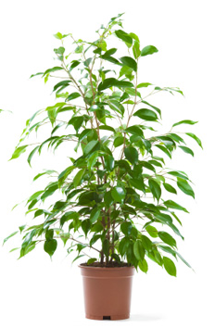
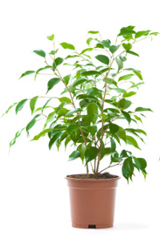
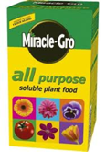
“How does Mike’s argument support his idea that plant gains weight from materials that came from the soil?”
Plants have roots to take up nutrients from the soil to grow.
Plant grown without fertilizer
Plant grown with fertilizer
Plant = 50 g
Plant = 65 g
Mike
Fertilizer = 3 g
Notes:
Mike explains, ‘Plants have roots to take up nutrients from the soil to grow.’ Mike adds some evidence to his argument and explains ‘A plant grown with no fertilizer weighed 50 g, and a plant grown with 3 g of fertilizer weighed 65 g.’”
“How does Mike’s argument support his idea that plant gains weight from materials that came from the soil?”
“Are their some weaknesses in Mike’s argument? Explain what they are.”
What evidence would strengthen Mike’s argument?
Good responses to this question notice that the difference in weight between these two plants cannot be explained by only 3 g of added fertilizer. Scientific Inquiry framing of the purpose of this experiment is that the claim involves tracing matter or energy. Evidence is evaluated by reasoning: using an atomic-molecular models and principle of conservation to constrain the argument.

Slide 14
Student response to Mike’s experiment
TEACHER: Can you explain what Mike’s argument was?
MABEL: His argument was that the plant was growing better with the fertilizer because it is—it has nutrients in it and it helps the roots grow and it takes the nutrients up through the roots and puts it towards the trunk of the tree.
TEACHER: Okay. So, how does—how is Mike’s argument supported by this evidence?
MABEL: It’s supported by the weight. He weighed it, one without fertilizer, and then, he added three grams of fertilizer and weighed it after the same amount of time and it grew more.
Notes:
Here the student, Mabel, substitutes the experiment’s real claim and question “the plant gains most of its weight from materials that came from nutrients in the soil,” with a different question that “what is the best approach to growing plants?” and the result is about “the plant was growing better with fertilizer.” Mabel is paying attention to the result somewhat– but only as a way to identify a winner… and this a satisfying result without reasoning using the mass data in a critical way accounting for matter using principles of conservation. So Mable did not notice that the plant’s increase in mass was greater than the mass of the fertilizer added.

Slide 15
Purpose of Investigation | Strategies for argumentation
Naïve inquiry Find the cause: What made an event happen? | Claim is cause and effect regardless of stated research question. Evidence, including personal experience, shows connection between cause and effect
Naïve engineering Find the winner or the best approach: What way works best? | Claim is about what works or how to make something happen. Evidence, including personal experience, identifies winner or what works
School science inquiry Replicate the right answer: How can I make the correct measurements to arrive at the correct result? | Claim is scientific correct answer regardless of stated research question. Evidence is authority of canonical science, confirmed by data.
Scientific inquiry Notice and manage uncertainty: What conclusions are warranted by the data and by scientific reasoning? | Claim involves tracing matter or energy. Evidence is evaluated by reasoning: using an atomic-molecular models and principle of conservation to constrain the argument.
Notes:
Enginnering is to manipulate or control variables to produce a desired outcome. The Mike interview question tended to result in students giving “Naïve Engineering”

Slide 16
Purpose of Investigation | Strategies for argumentation
Naïve inquiry Find the cause: What made an event happen? | Claim is cause and effect regardless of stated research question. Evidence, including personal experience, shows connection between cause and effect
Naïve engineering Find the winner or the best approach: What way works best? | Claim is about what works or how to make something happen. Evidence, including personal experience, identifies winner or what works
School science inquiry Replicate the right answer: How can I make the correct measurements to arrive at the correct result? | Claim is scientific correct answer regardless of stated research question. Evidence is authority of canonical science, confirmed by data.
Scientific inquiry Notice and manage uncertainty: What conclusions are warranted by the data and by scientific reasoning? | Claim involves tracing matter or energy. Evidence is evaluated by reasoning: using an atomic-molecular models and principle of conservation to constrain the argument.
Notes:
Continuing the interview– students also does something else that we thought was interesting in both Karen and Mike interviews. Other students offer criticism related to experimental design and methods. For example, Mabel later points out errors that the experimenter might make. Other students mention factors that need to be controlled for a fair test like water and sunlight, and the number of replications. This is useful criticism, although, the students offered these criticisms without engaging in claims, evidence, reasoning. CLICK Instead of reasoning about the evidence, the student was asking: “how can I make the correct measurements to arrive at the right answer?” CLICK Authority is set by teacher, textbooks.
We think that this way of reasoning about an experiment may be related to students experiences in classrooms where investigations are focused on procedure, rather than reasoning.

Slide 17
School Science Inquiry
Careful procedures and reducing experimenter errors are the best way to manage uncertainty.

Slide 18
Inquiry practices in a context
Uncovering student difficulties inquiry in carbon-transforming processes:
Specific difficulties related to principles of conservation and atomic-molecular models
results in more powerful translation to teaching and learning activities that connect inquiry and student explanations
Notes:
For example: Using principles of conservation to show that Mass changes = atoms moving
2) What is meaningful to students when doing inquiry investigations? Results in specific important ways to revise our curriculum to connect inquiry to student explanations

Slide 19

Acknowledgements
Environmental Literacy Group
Andy Anderson
Jennifer Doherty
Joyce Parker
Jane Rice
Acknowledgment: This work is supported by NSF-DRK12 (#1020187). Any opinions, findings, and conclusions or recommendations expressed here are those of the authors and do not necessarily reflect the views of the National Science Foundation.

